Slide 1
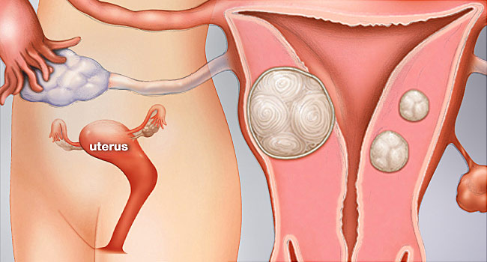
Uterine Fibroids and Uterine Artery Embolisation
Dr Veronique Caty, MD FRCPC
Dr Alessandra Cassano-Bailey, MD FRCPC

Slide 2
Disclosures
No financial disclosures
Interventional Radiologists
Notes:
As we are interventional radiologists performing UFE, we are biased because it is a procedure we regularly perform and it is what we are most familiar with. Acknowledging this, a similar bias exists for our for gynecology colleagues who are more familiar with the procedures they regularly perform, that is myomectomy and hysterectomy. In this sense, we are all biased.

Slide 3
Outline
Uterine Fibroids
Definition
Symptoms
Diagnosis
Fibroid treatment
Uterine artery embolisation
Myomectomy
Hysterectomy
HIFU
Medical

Slide 4
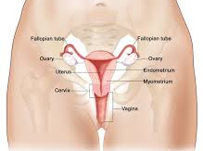
Uterine Fibroids
Noncancerous growths
Develop in the muscular wall of the uterus
Some fibroids are asymptomatic
Symptomatic Fibroids
size
location
Notes:
While some Fibroids may be asymptomatic, other may cause clinically significant and debilitating symptoms. Factors include Size and Location of the fibroids

Slide 5
Fibroid symptoms
Uterine Pressure
Pelvic Pain
Heavy Menstrual Bleeding
Constant Urge to Urinate
Painful Sexual Intercourse
Enlarged Abdomen

Slide 6
Fibroids
Up to 40% of women have fibroids
Of those, up to 25% have symptoms severe enough to seek medical treatment
EA Stewart, CL Cookson, RA Gandolfo, R Schukze-Rath, Epidemiology of uterine fibroids: a systematic review, BJOG, vol 124, I 10 September 2017 ; 1501-1512

Slide 7
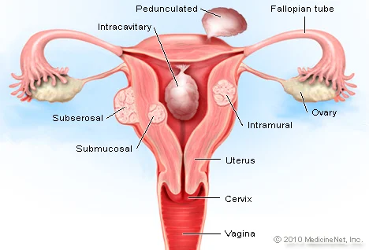
Fibroids localisation
Fibroids can occur in various localisation in uterus
Some location can cause more symptoms

Slide 8
Fibroid
Imaging
Ultrasound
Trans pelvic and Endovaginal
Usually first exam performed if symptoms are present
Magnetic Resonance Imaging
Can be used to further characterise fibromas

Slide 9
Fibroid
Treatment Options
Sony Singh and Belland. CMRO. 2015
Notes:
Fibristal was withdrawn in Canada in 2020 secondary to severe liver dysfunction reported following intake

Slide 10
Fibroid
Medical Treatment
Usually short term (symptoms will recur once treatment is stopped)

Slide 11
Fibroid
Treatments:
Locoregional
Uterine artery embolisation
Myomectomy
Hysterectomy
Myolysis
destruction of fibroids with laser, ultrasound
Not currently readily available in Canada
Endometrial ablation
destruction of endometrium through cervix with laser or radiofrequency:
High recurrence rate
Notes:
We will focus on comparing the first three treatments

Slide 12
Fibroid
Treatments:
Myomectomy
How?
Resection of uterine fibroids through abdominal incision (laparotomy) or through smaller incision using cameras (laparoscopy)
Who?
Gynecologists
Why ?
Preserves fertility
Preserves Uterus
Long term satisfaction rate high
Manyonda I, Belli AM, Lumsden MA, Moss J, et all Uterine-Artery Embolization or Myomectomy for Uterine Fibroids, NEJM july 30 383:440-451

Slide 13
Fibroid
Treatments:
Myomectomy
How?
Surgical removal of Uterus
Trans abdominal
Transvaginal
Who?
Gynecologist
Why?
Permanent solution
No desire of fertility or preservation of uterus

Slide 14
Fibroid
Treatments:
Uterine Artery Embolisation (UFE)
How?
Tiny skin incision
Catheter inserted and guided with imaging towards uterine artery
Tiny particles injected to block blood flow to fibroids
causing them to shrink
Who?
Interventional radiologist
with assistance of technologists and nurses
Why ?
Minimally invasive intervention , no scars
Performed under conscious sedation (no general anesthesia)
Preserves uterus

Slide 15
Uterine Artery Embolisation (UFE)
Short recovery
Usually, 24 hours hospital stay
7 to 10 days off work
Symptom improvement
Heavy menstrual bleeding: 90%
Bulk symptoms: 80%
Size reduction, from 30 to 50%

Slide 16
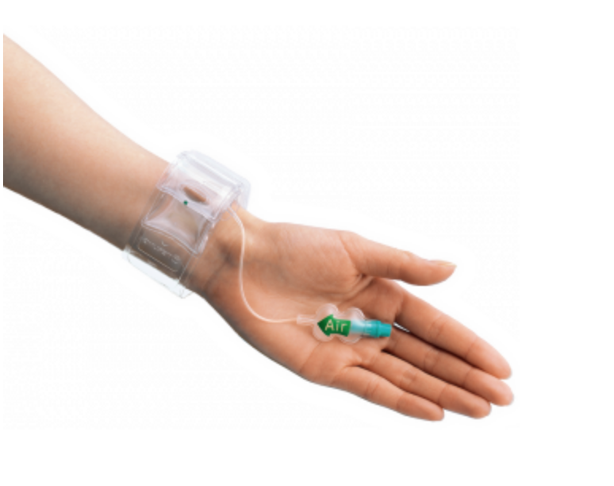
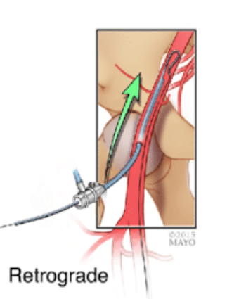
Uterine Artery Embolisation (UFE):
How it's performed
Access
Tiny sheath (2 -2.5mm hole)
common femoral artery
radial artery
Pain control
local anesthetic to access site
conscious sedation (fentanyl & Midazolam most commonly)
local (hypogastric )nerve block
PCA for overnight pain (some sites)
https://www.terumois.com/products/access/glidesheath.html
April 2015 Techniques in Vascular and Interventional Radiology 18(2)

Slide 17
Uterine Artery Embolisation (UFE)
Normal post intervention course:
Pain
Fatigue (post embolisation syndrome)
Nausea and vomitting
Treatment post intervention:
Analgesia
Anti nausea
Active support: rest, hydratation etc

Slide 18
Uterine Artery Embolisation (UFE):
Contraindications
Infection
Cancer
Pregnancy
Intracavitary fibroids
increases risk of expulsion
Notes:
Intracavitary fibroids= relative contrindications

Slide 19
Uterine Artery Embolisation (UFE):
Potential Complications
Infection (endometritis)
0.5%
Foul smelling discharge, fever
Fibroma expulsion
rate depends on fibroids localisation
up to 10%
Vaginal expulsion of small gelatinous parts
Non target embolisation and ovarian dysfunction
5-7%
Age above 45 years old leads to more occurence
Thrombophlebitis or pulmonary embolism
0.25%

Slide 20
Uterine Artery Embolisation (UFE):
Fertility
Pregnancy reported following uterine artery embolisation
Risk of abnormal placentation, prematurity and low birth weight for following pregnancies
NOT FIRST CHOICE IF YOU WANT TO GET PREGNANT
Notes:
Intracavitary fibroids= relative contrindications

Slide 21
Uterine Artery Embolisation (UFE):
Case Example
45 yo female G2P2
No desire for further pregnancy
-ve medical Hx
Symptomatic fibroids
heavy menses leading to anemia
Treatment options discussed
Myomectomy, hysterectomy, uterine artery embolisation
Pt chooses UFE
Uterine preservation
Shorter recovery

Slide 22
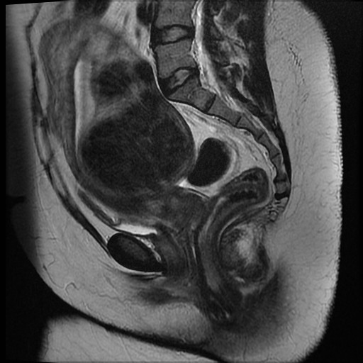
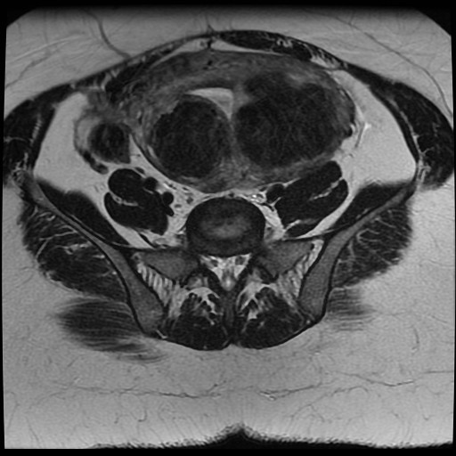
Pre

Slide 23
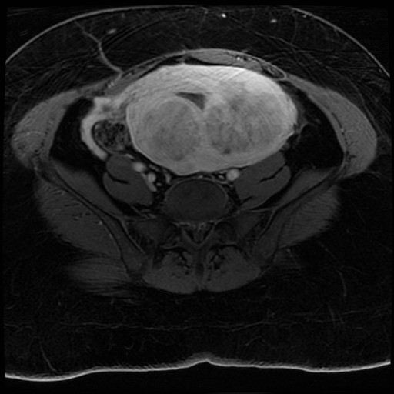
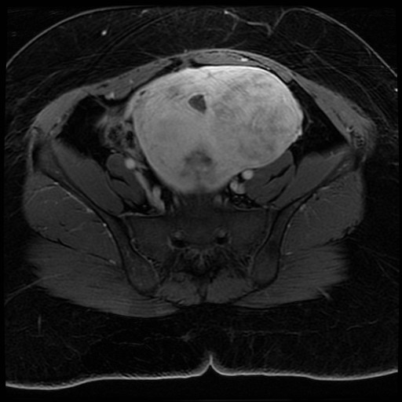
Pre

Slide 24
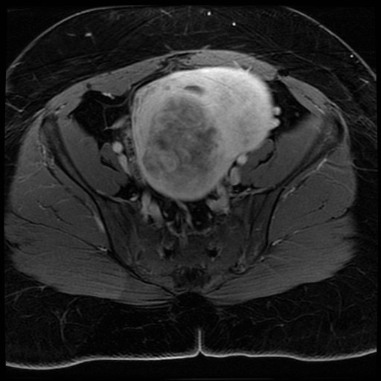
Pre

Slide 25
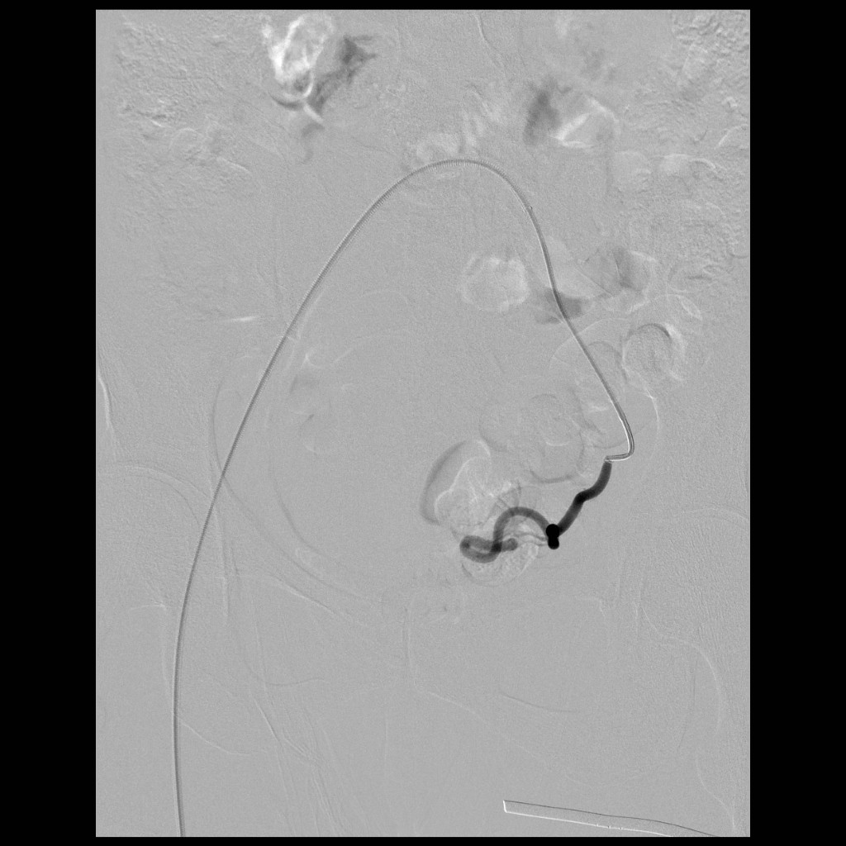

Slide 26
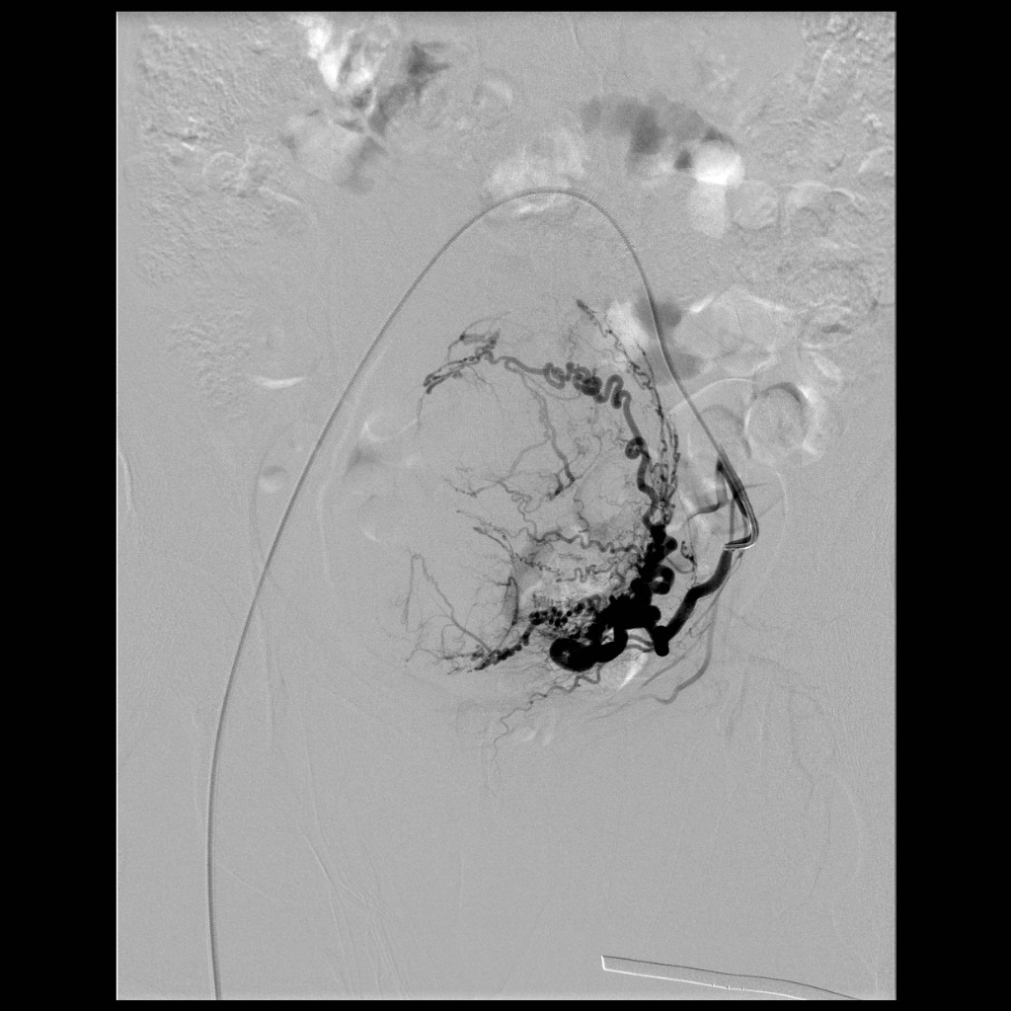

Slide 27
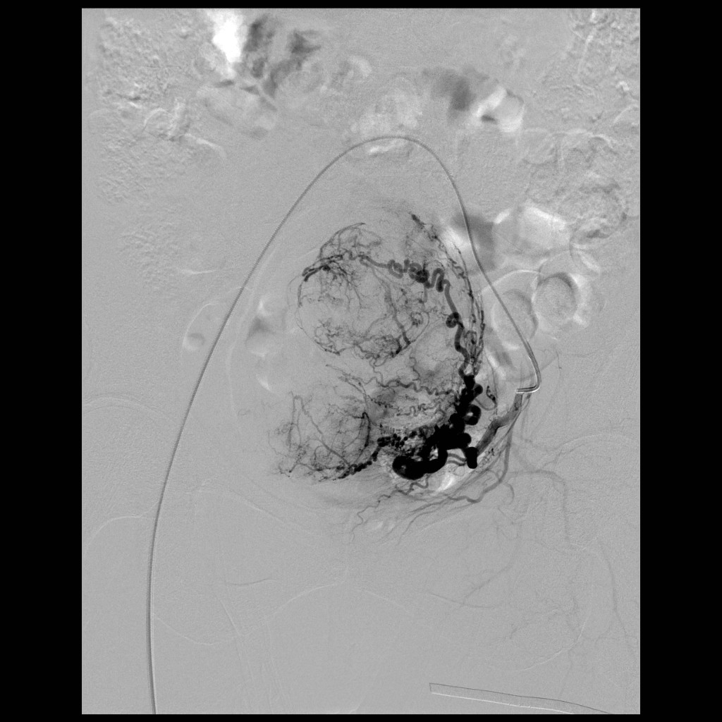

Slide 28
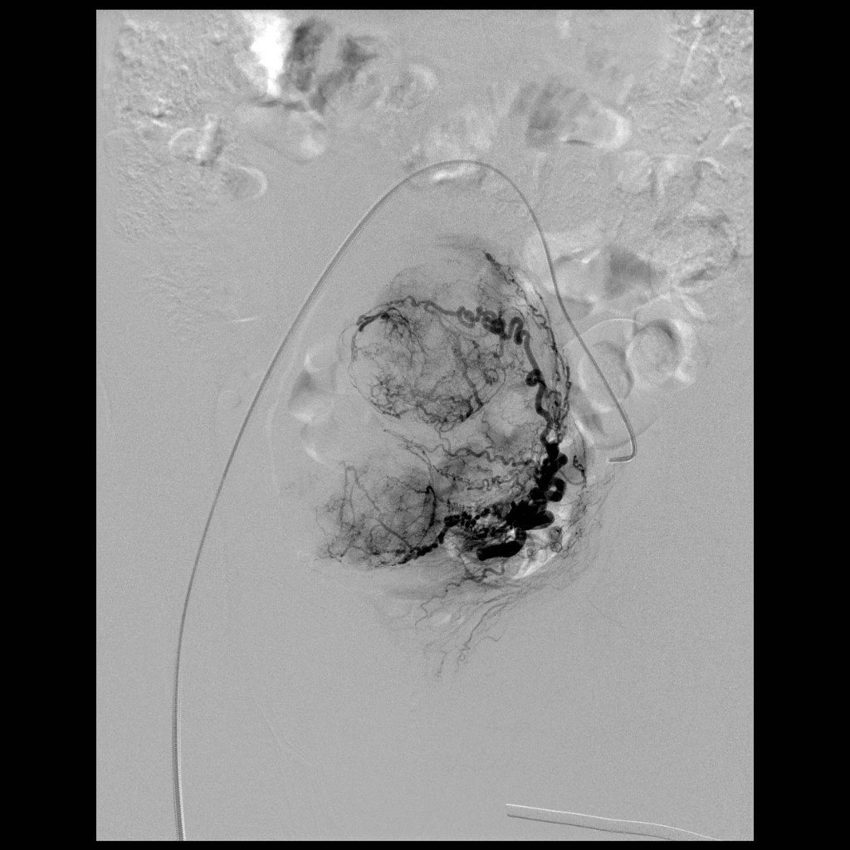

Slide 29
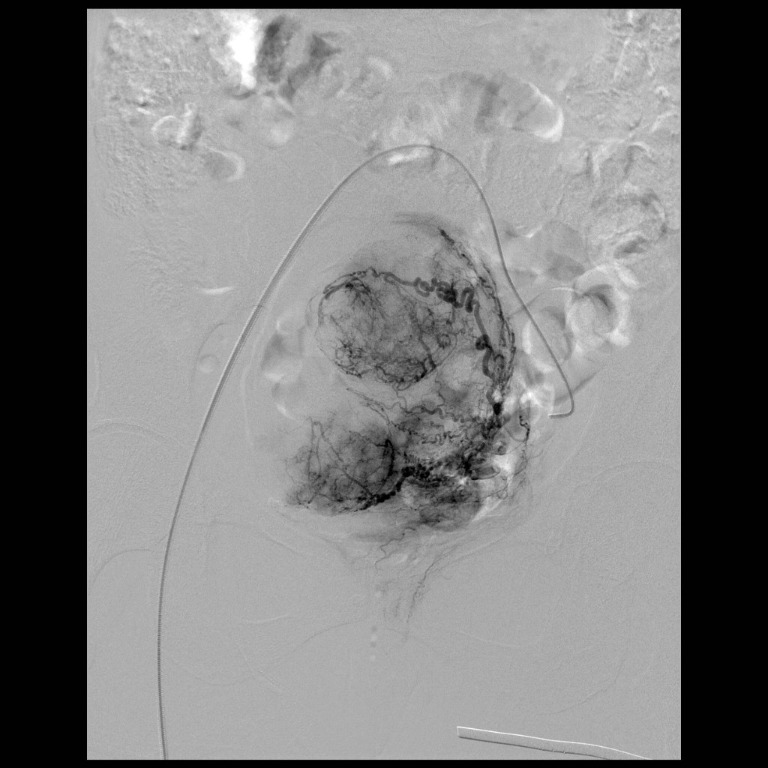

Slide 30
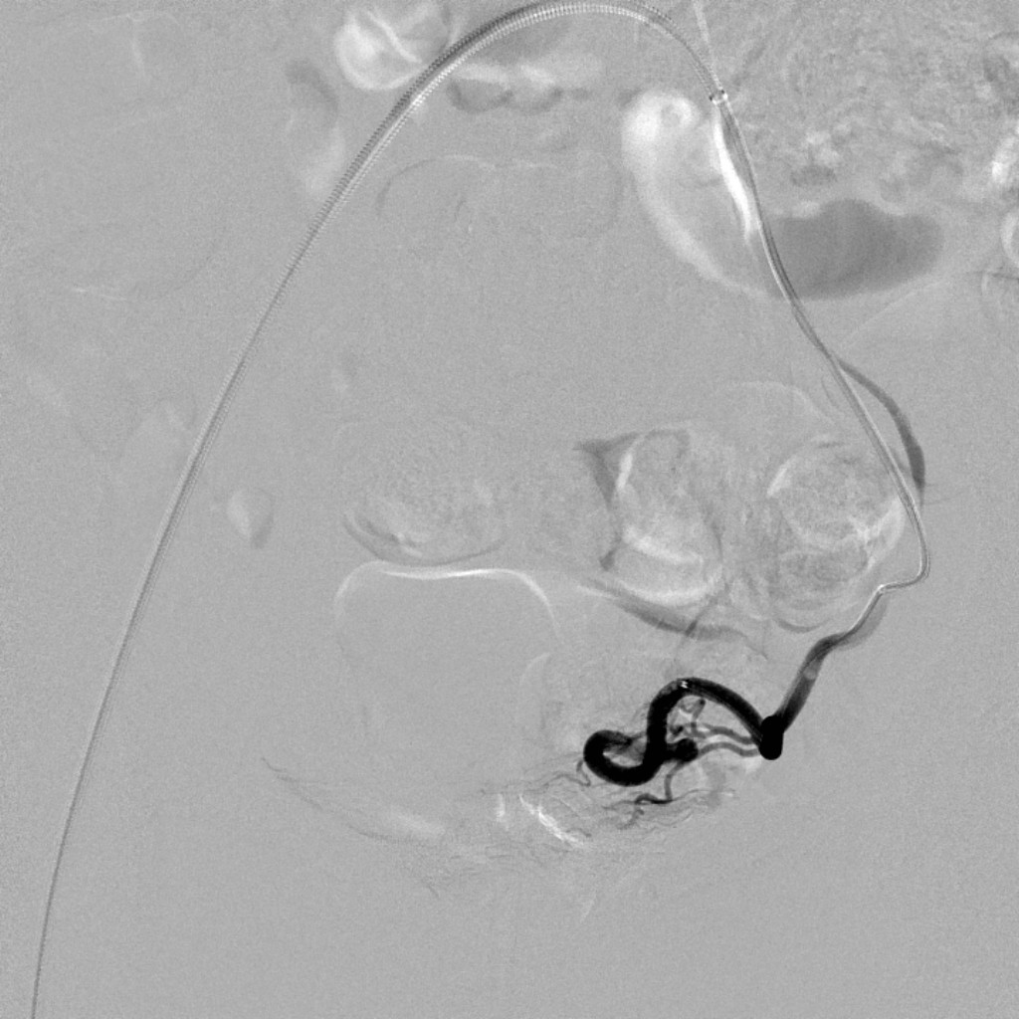

Slide 31
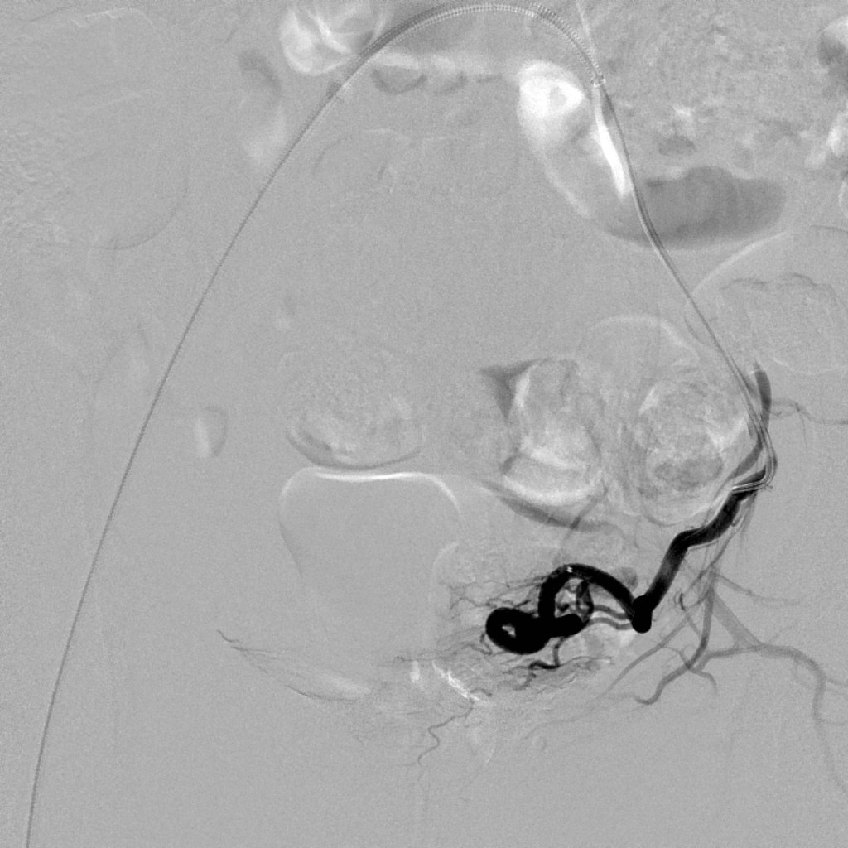

Slide 32
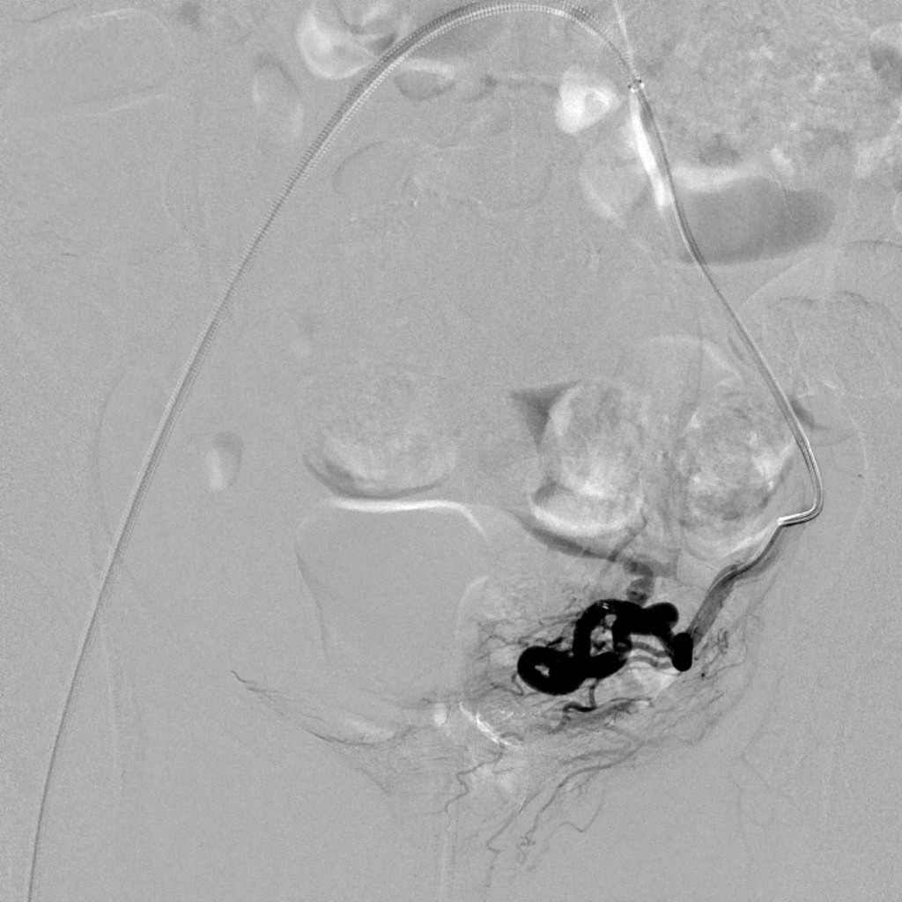

Slide 33
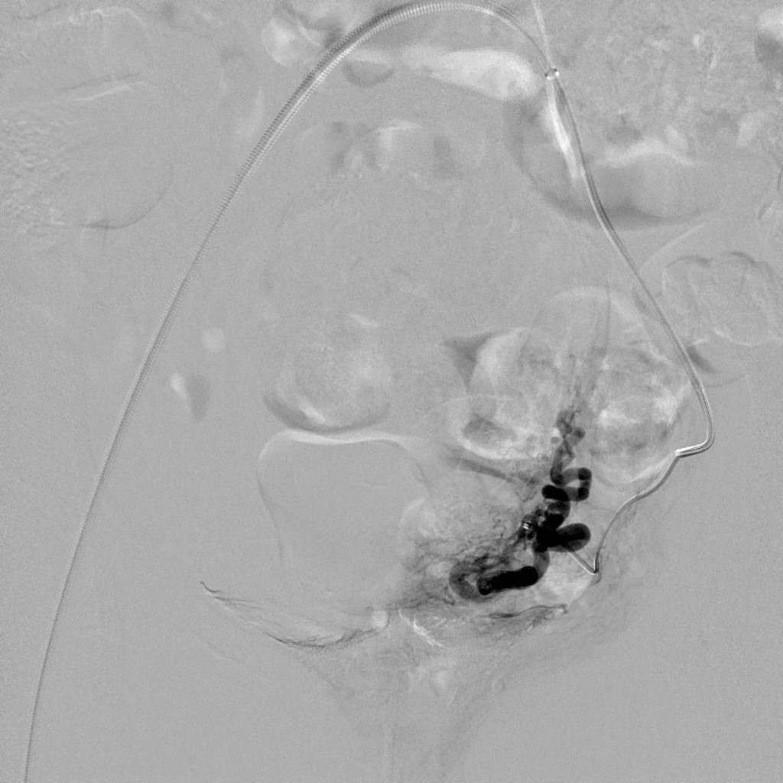

Slide 34
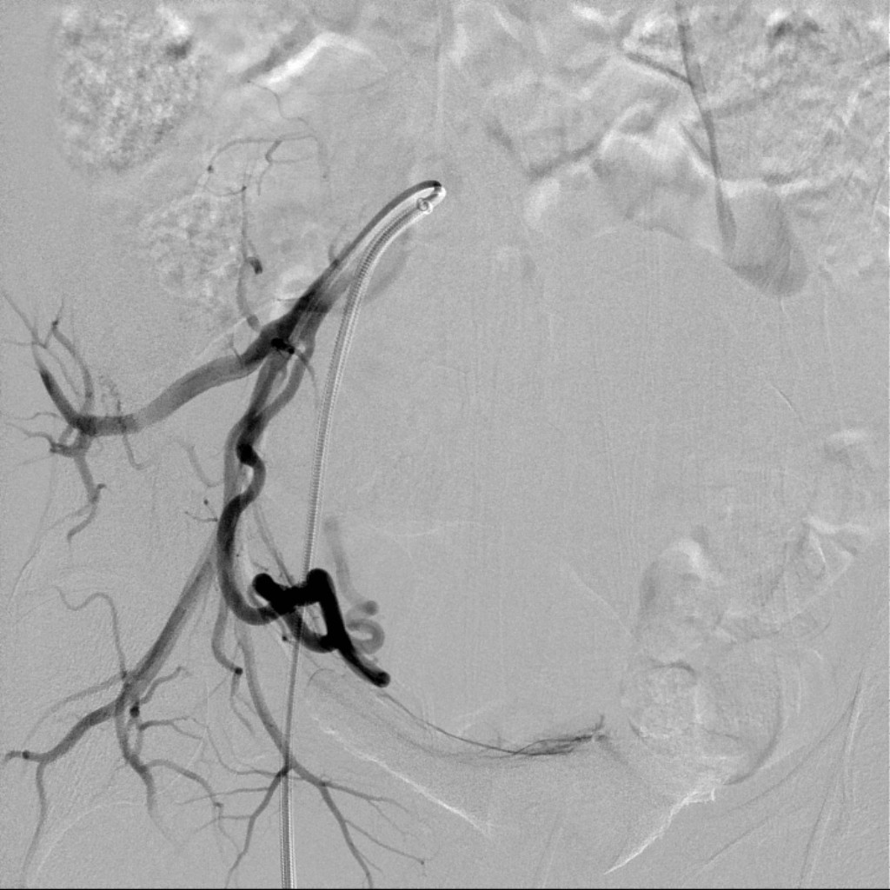

Slide 35
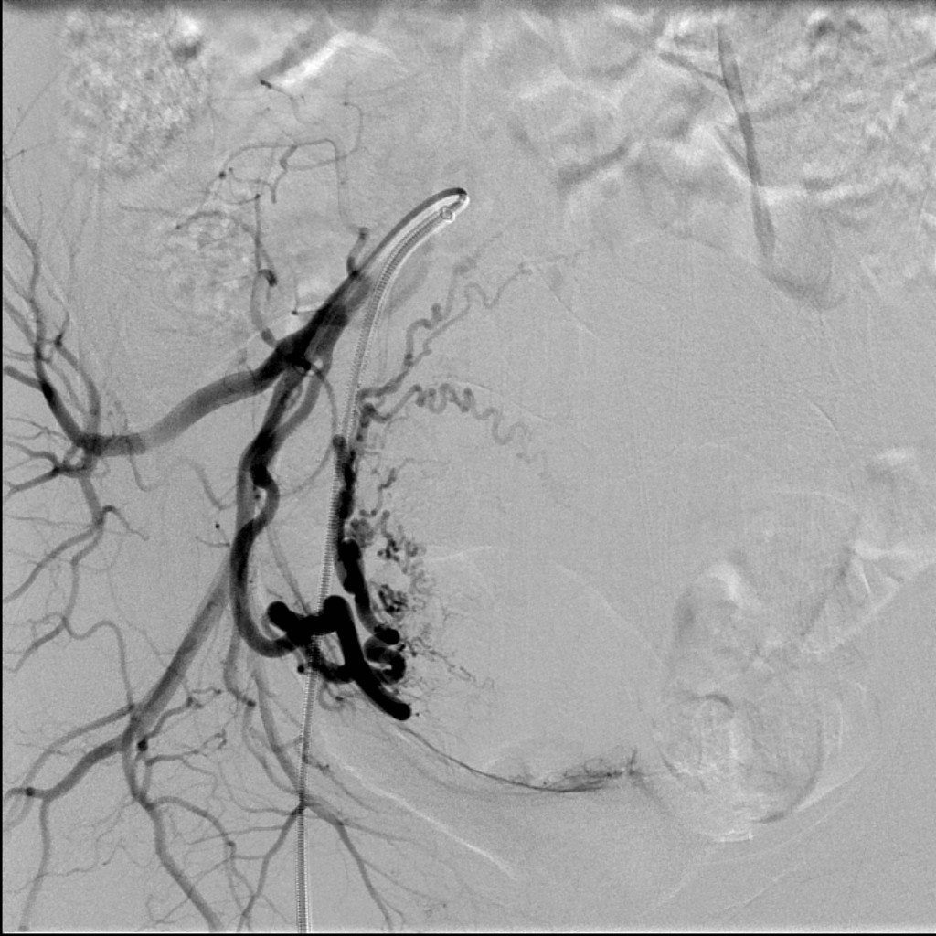

Slide 36
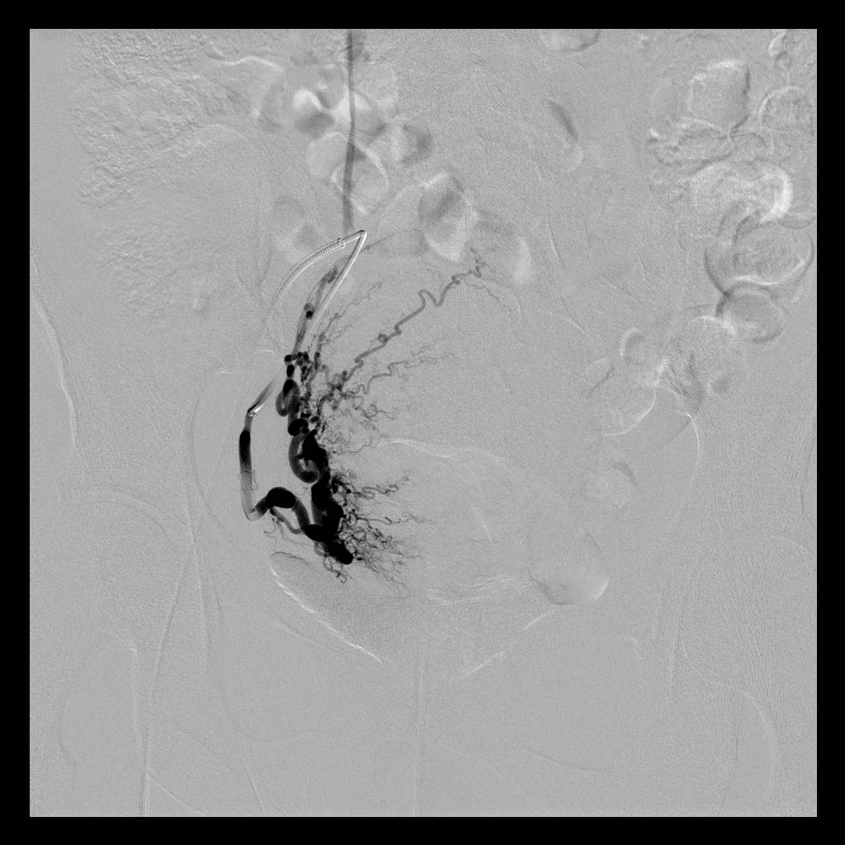

Slide 37
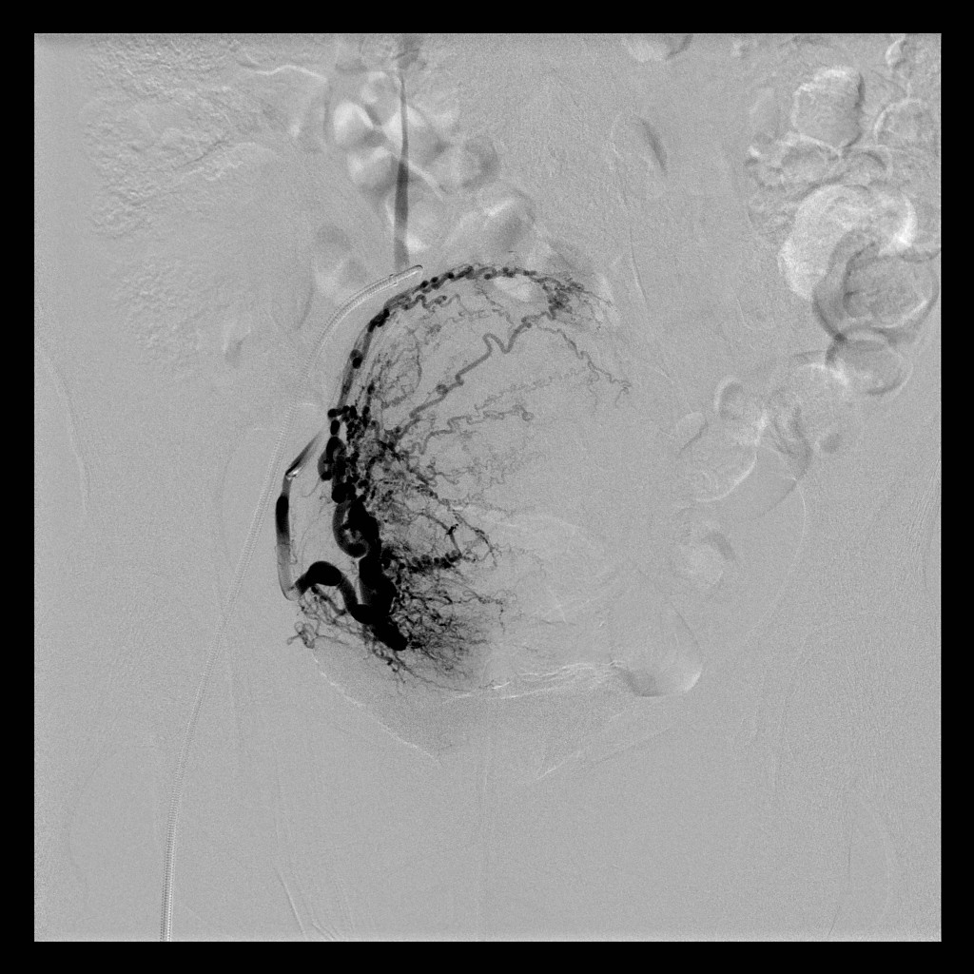

Slide 38
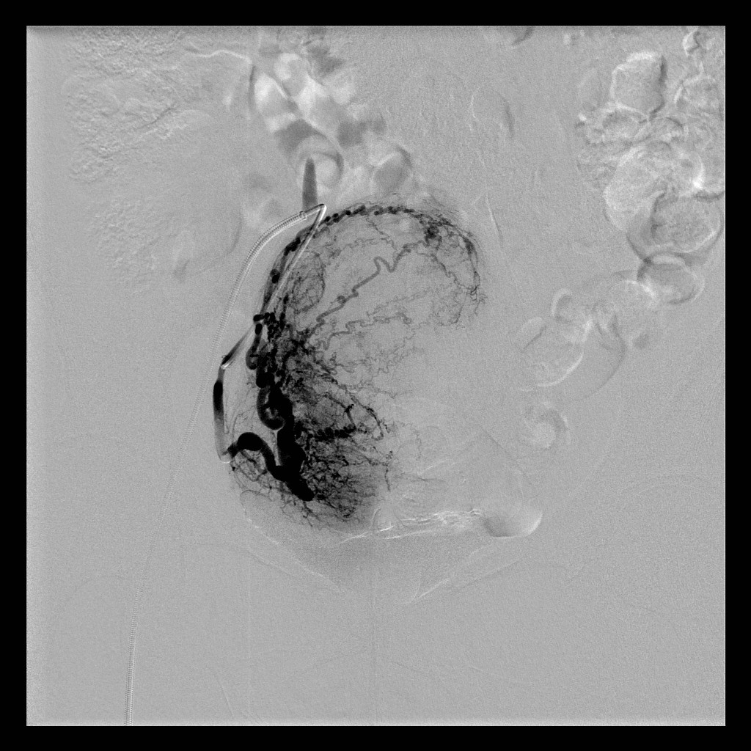

Slide 39
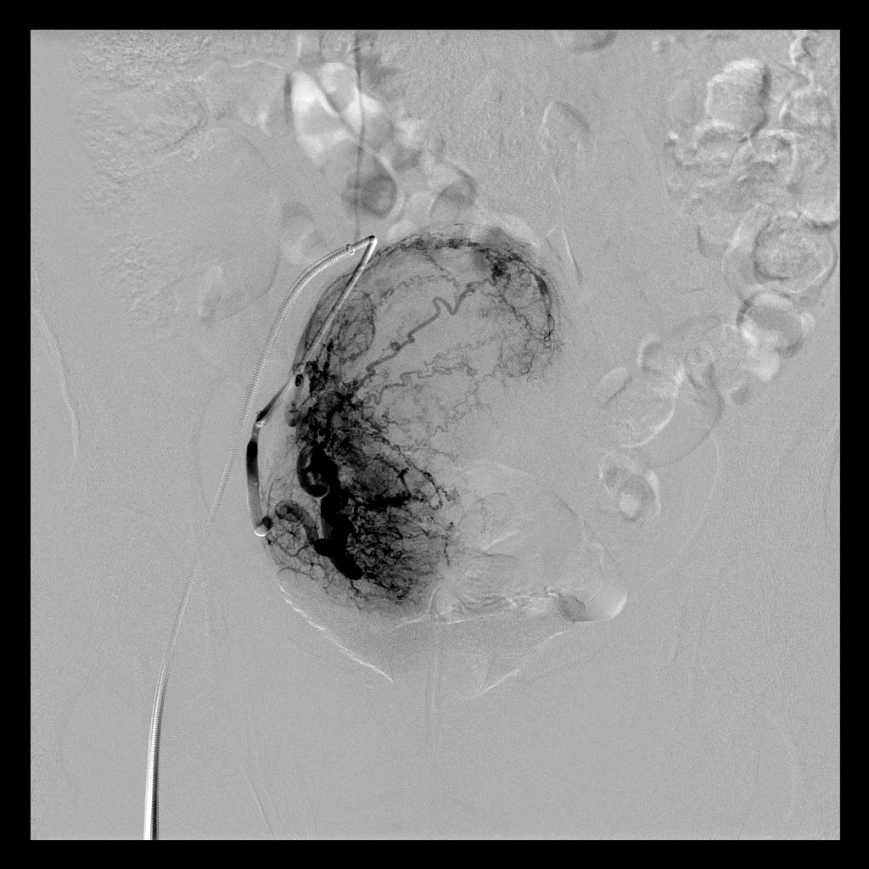

Slide 40
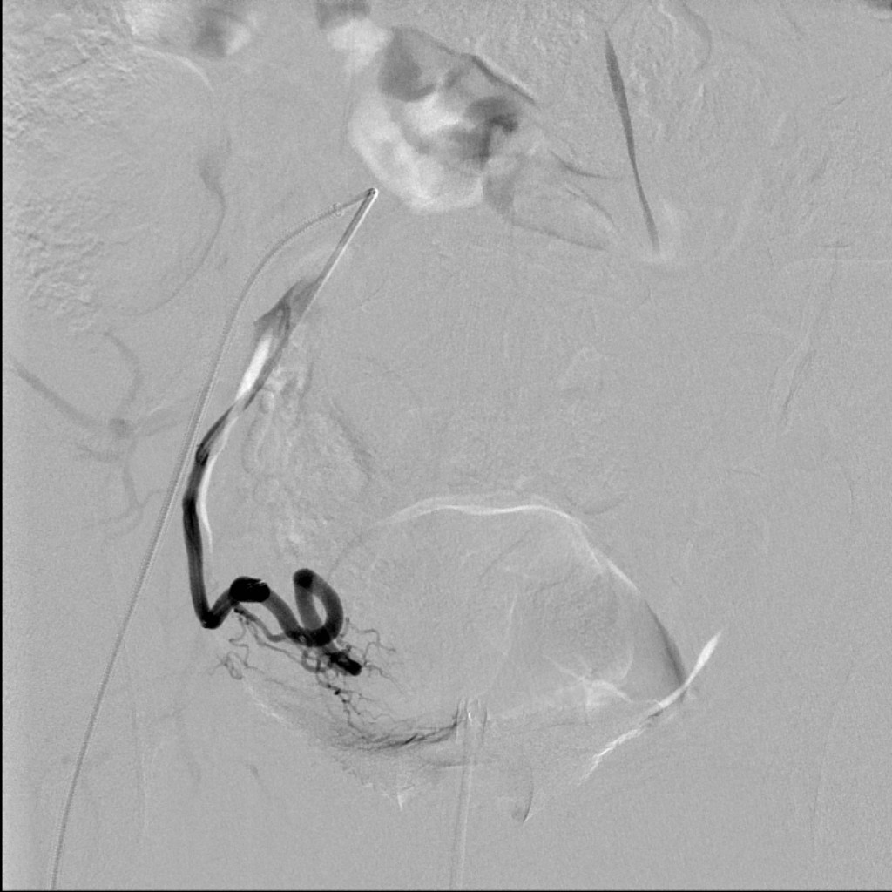

Slide 41
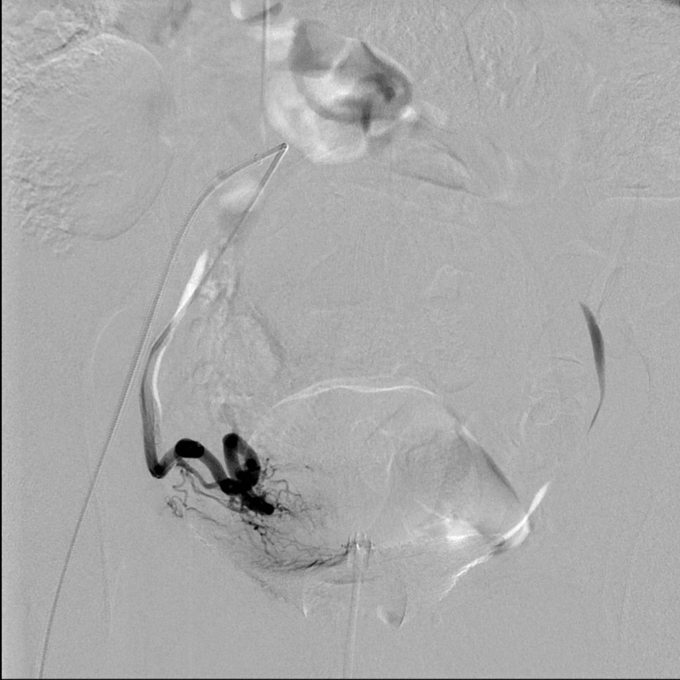

Slide 42
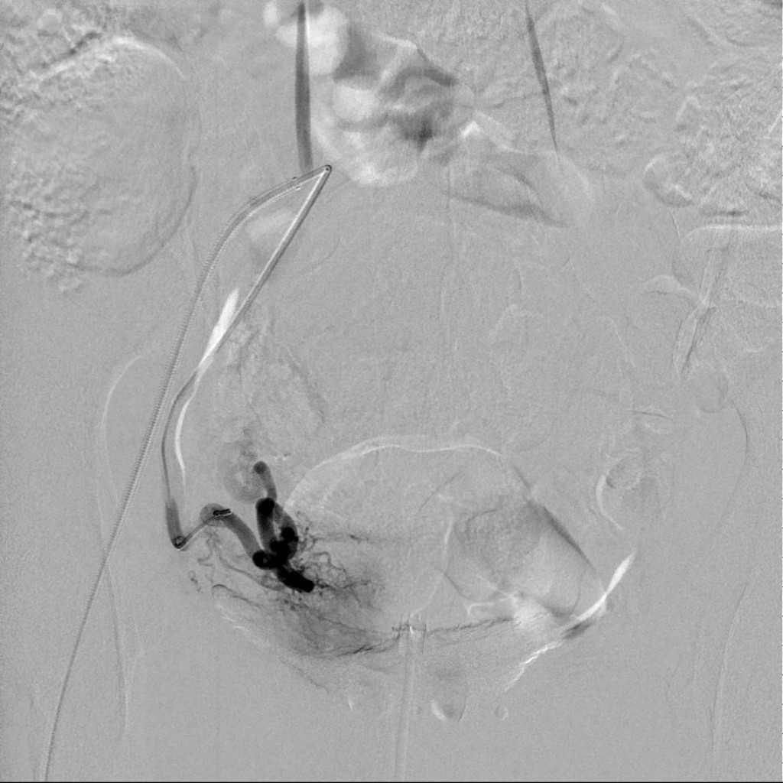

Slide 43
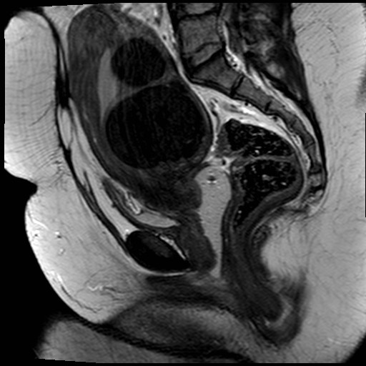
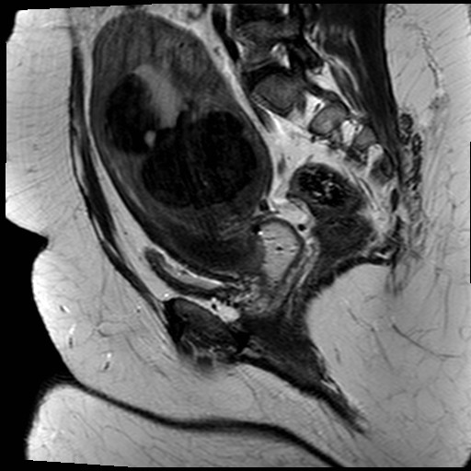
Post

Slide 44
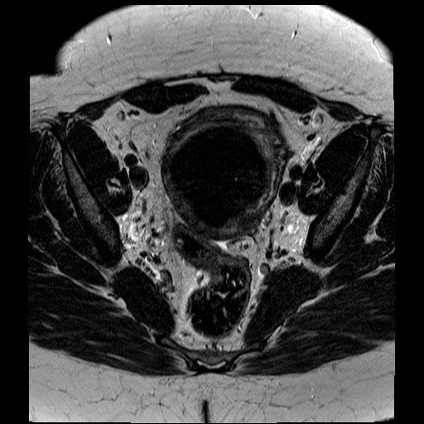
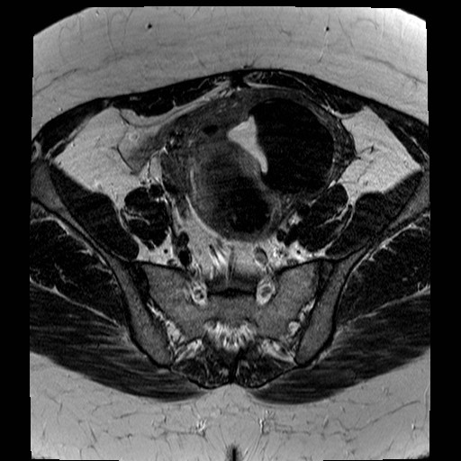
Post

Slide 45
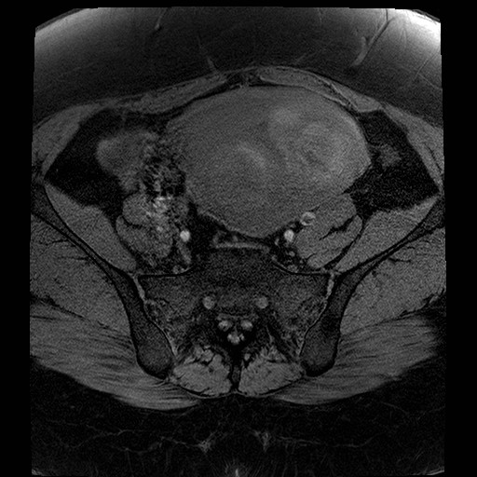
Post

Slide 46
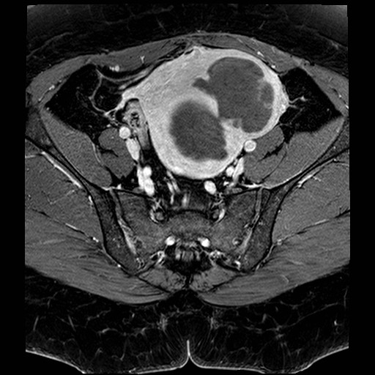
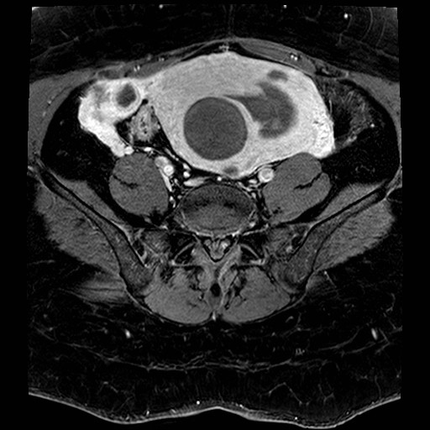
Post

Slide 47
Pre - Post

Slide 48
Conclusions
Fibroids are benign but can lead to symptoms significant enough to seek treatment
Treatment options exists and can be discussed with your doctor
Uterine fibroid embolisation is a good option which has the following benefits:
Minimally invasive
Uterine preservation
Faster recovery
High success rate of symptom relief

